Slide 1
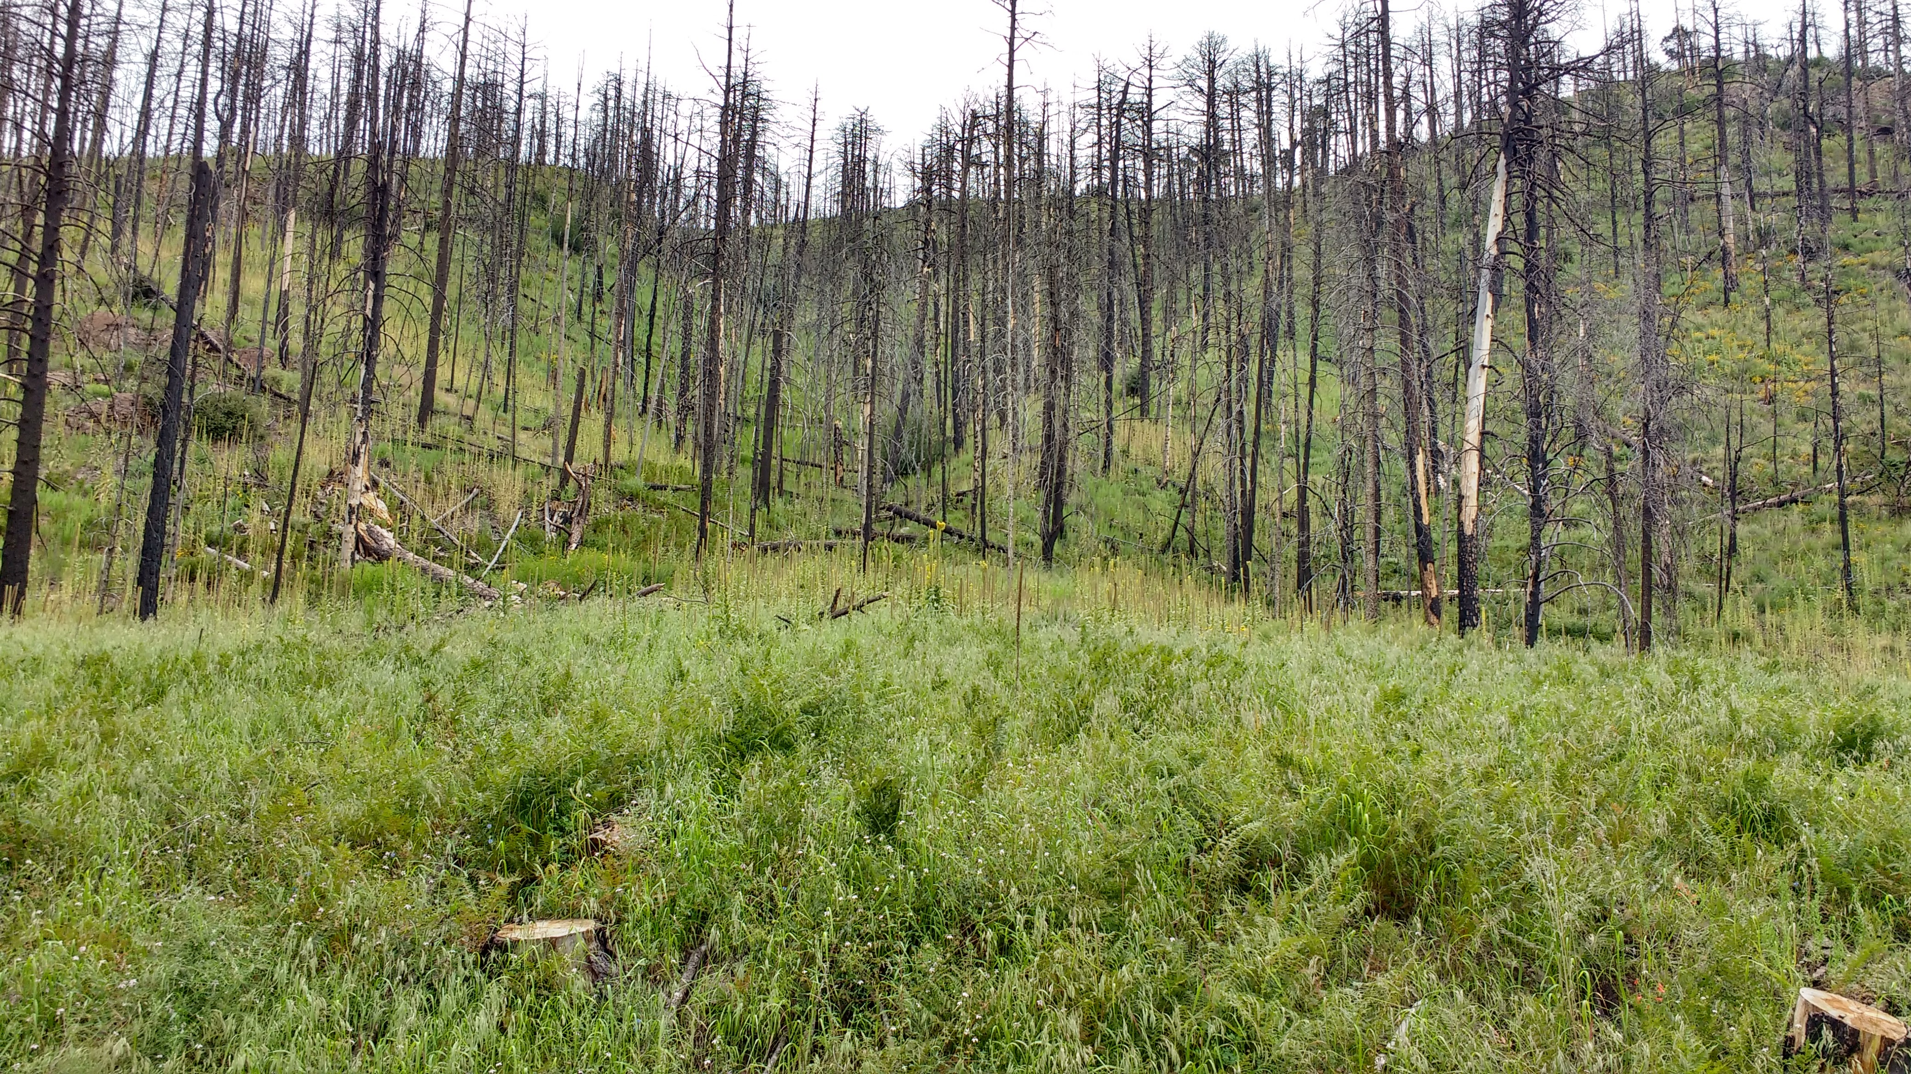
Fire effects on ectomycorrhizal communities in geographically isolated sky islands

Slide 2
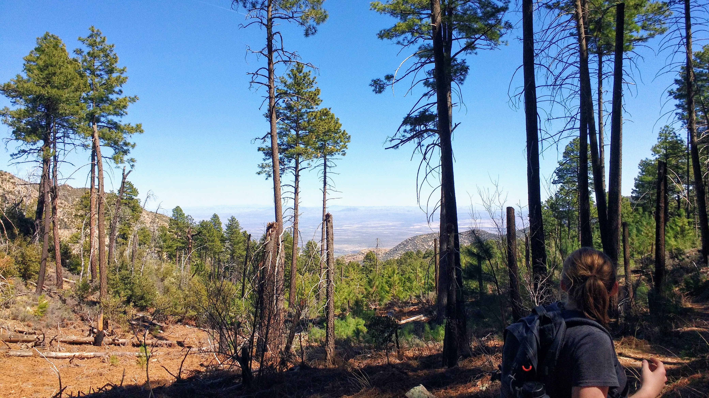
Background
Sky islands are isolated forests located above the Chihuahuan and Sonoran Deserts.
Sampled in the Pinaleno and Santa Catalina Mts. which are at the same lat.
Both ranges experienced burns ~ 14 years ago.
2004 Pinaleno Mts.
2003 Santa Catalina Mts.

Slide 3
Background
Population size and isolation can influence genetic diversity of an organism (citations)
Within smaller population sizes, genetic drift can have a stronger effect (citations)
Disturbances, such as wildfire, can further reduce genetic variation (citations)

Slide 4
Major questions/hypotheses
Questions:
Do ectomycorrhizal communities in isolated forest patches show a similar response to disturbance?
If not, what could be the underlying cause (e.g. is it stochastic or based on initial starting genetic pool)?
Hypotheses:
Burned sites will show higher diversity than unburned. (citations)
Ectomycorrhizal communities will differ more due to geographic location than disturbance.

Slide 5
Sampling
Santa Catalina Mts.
Pinaleno Mts.
5 trees per site
3 root cores per tree (15 cores per site)
3 soil cores per site
5 trees per site
3 root cores per tree (15 cores per site)
3 soil cores per site
Burned
X2
X2
5 trees per site
3 root cores per tree (15 cores per site)
3 soil cores per site
5 trees per site
3 root cores per tree (15 cores per site)
3 soil cores per site
Unburned
X2
X2

Slide 6
Range differences: Climate

Slide 7
Range differences: Soil difference based on burn

Slide 8
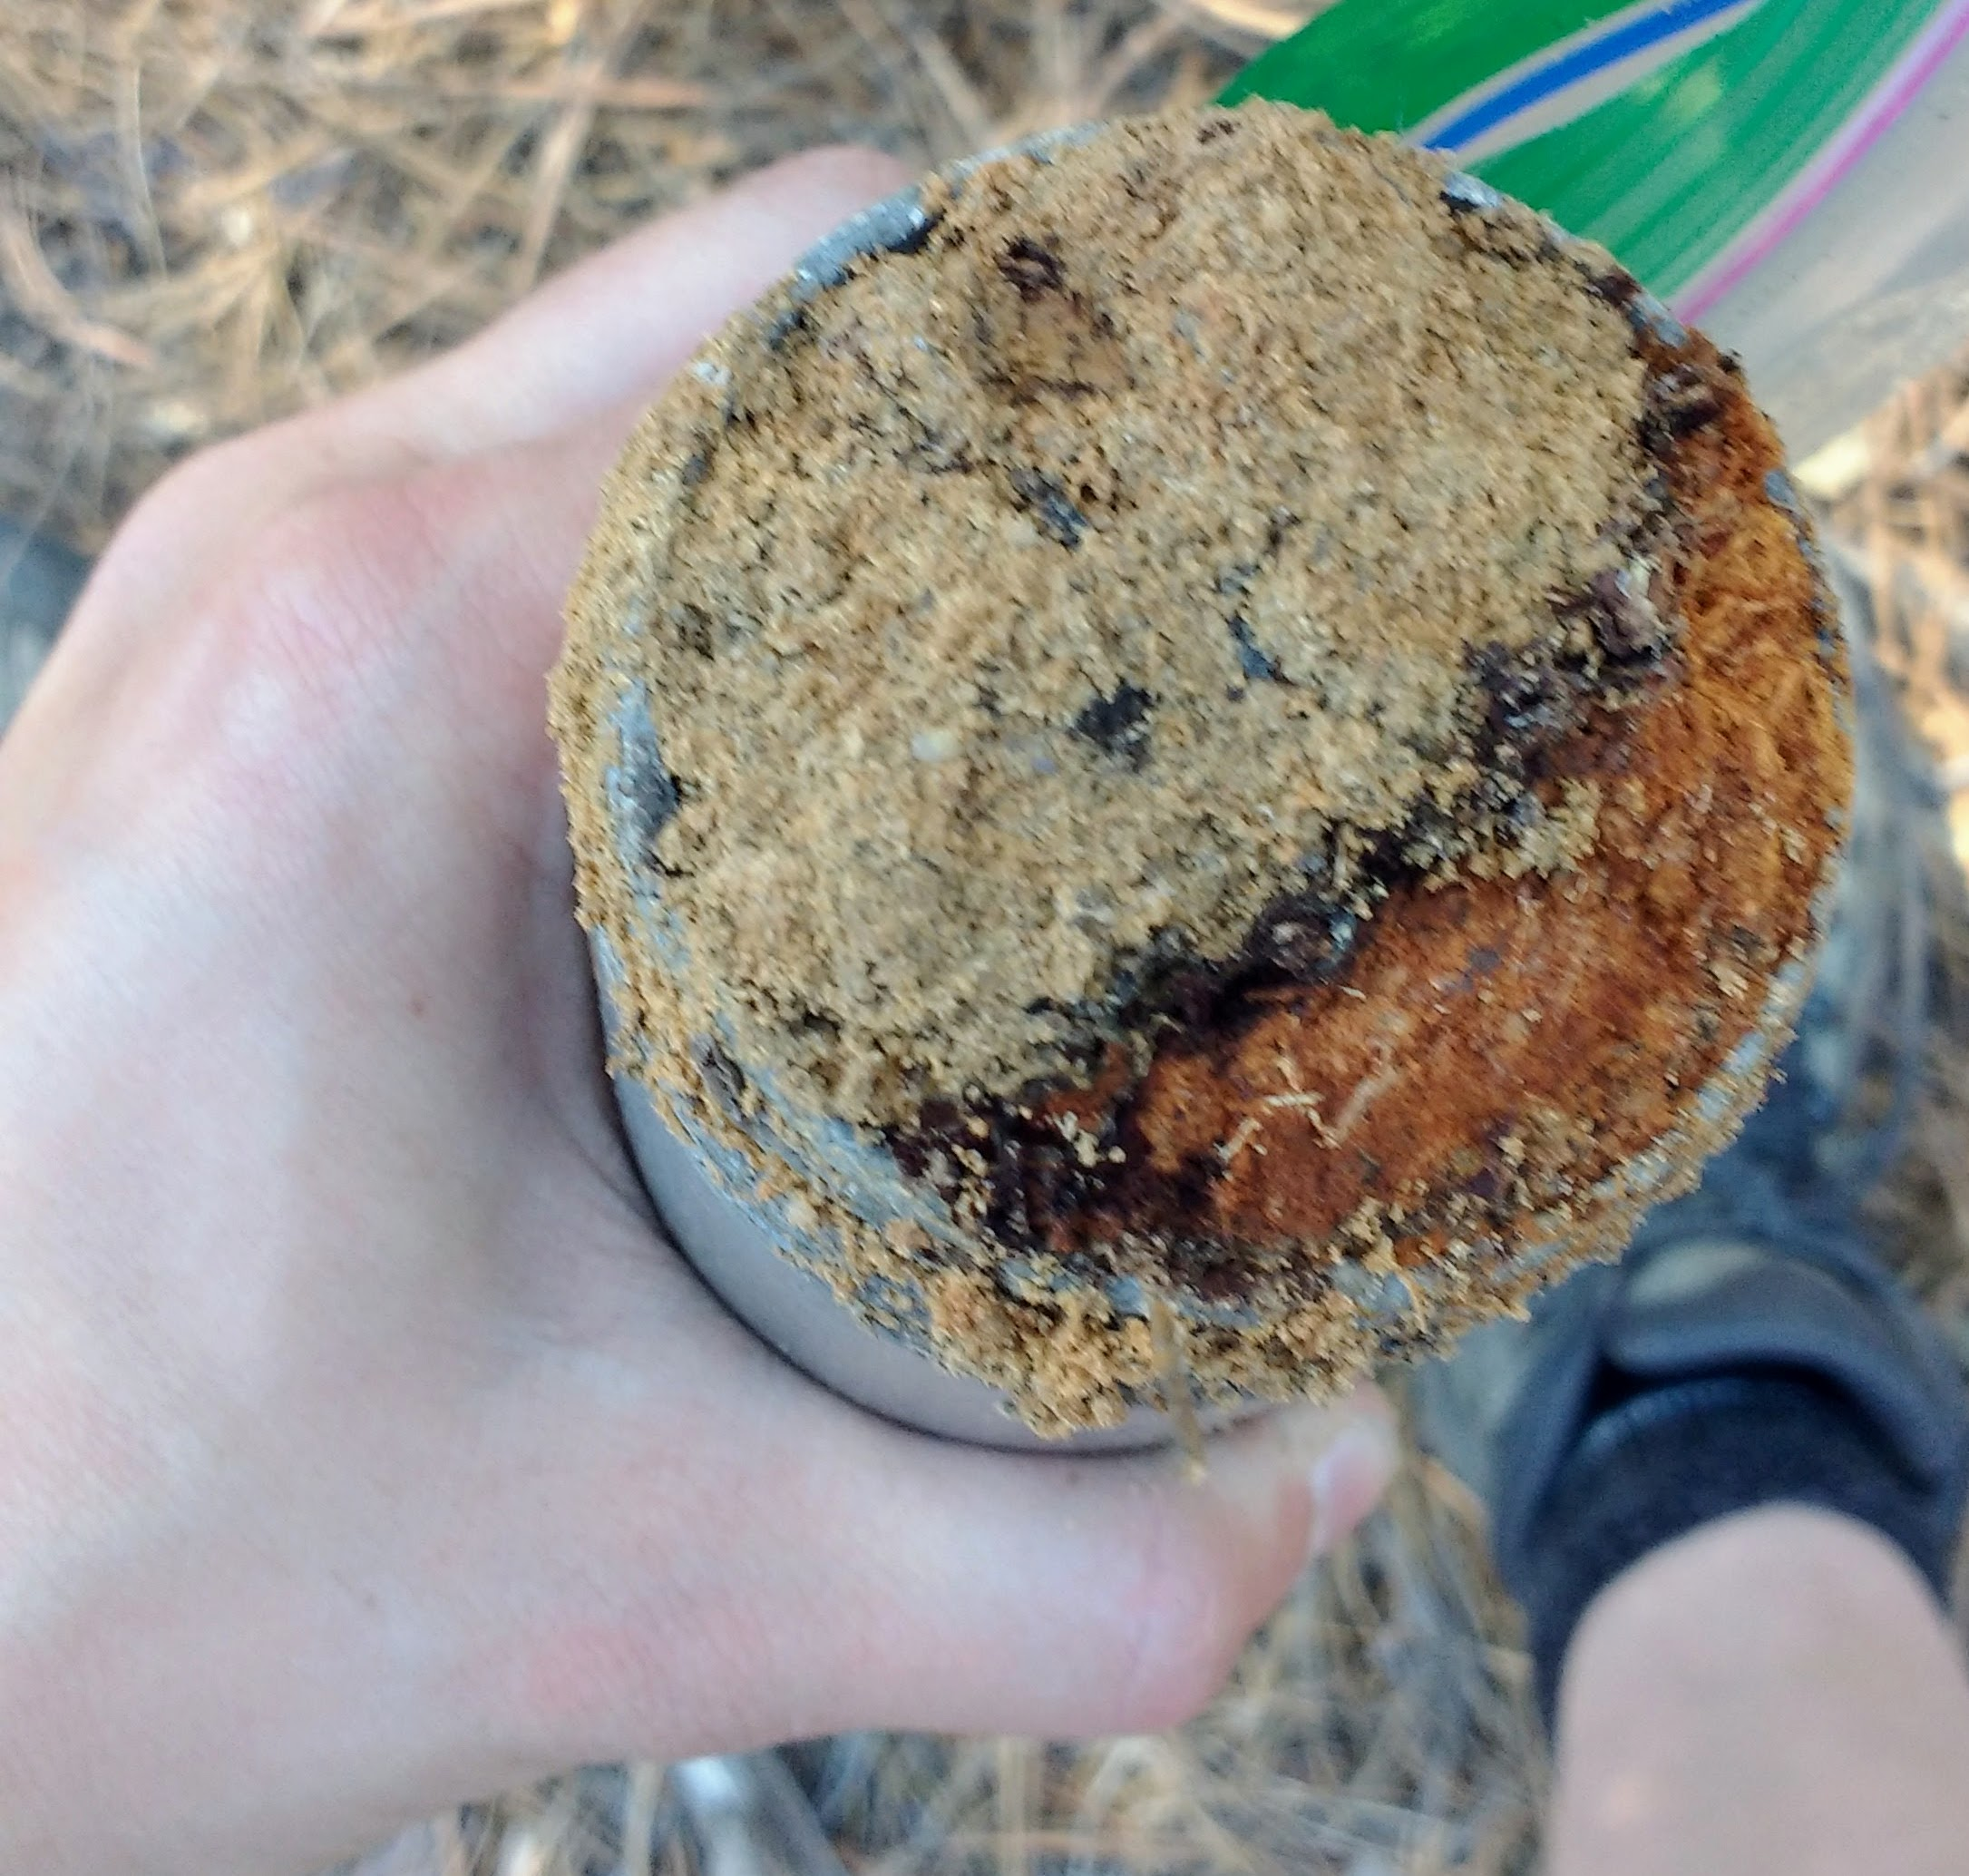
Range differences: Soil difference based on burn

Slide 9
Range differences: Diversity (Fisher’s alpha)
Pinaleno Mts.
Santa Catalina Mts.
Notes:
Burn status sig. different
Grouped by site

Slide 10
Range differences: Diversity (Shannon’s diversity)
Pinaleno Mts.
Santa Catalina Mts.

Slide 11
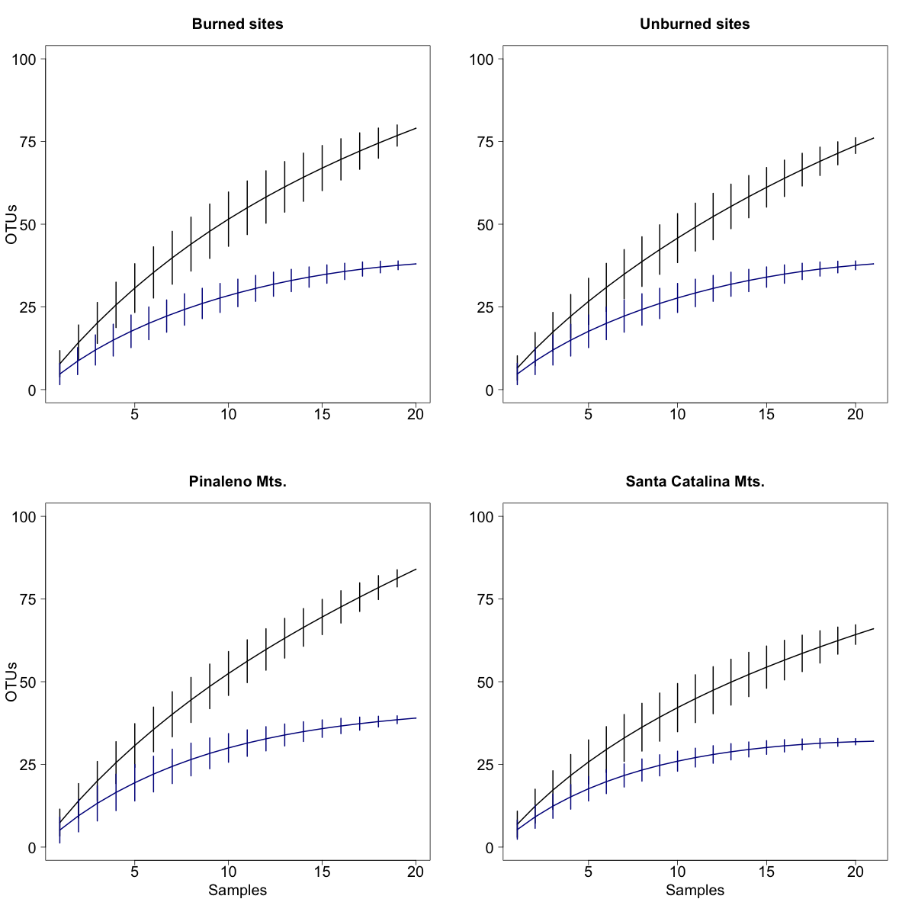
Species accumulation curves
Pinaleno Mts.
Santa Catalina Mts.
Burned
Unburned
Notes:
Burn status sig. different

Slide 12
Taxonomic differences: class level
Pinaleno Mts.
Santa Catalina Mts.
Burned
Unburned
Burned
Unburned
Notes:
No difference

Slide 13
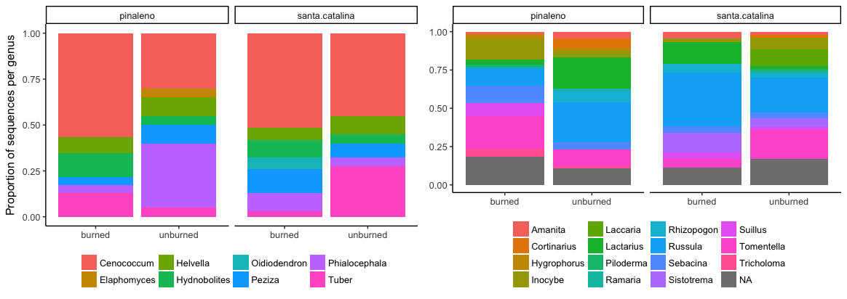
Taxonomic differences: genus level
Notes:
Range: Pearson's Chi-squared test data: range.tax
X-squared = 43.527, df = 18, p-value = 0.0006738

Slide 14
Community similarities:
At the site level, shows strong community similar based on geographic origin.
Notes:
Range: Pearson's Chi-squared test data: range.tax
X-squared = 43.527, df = 18, p-value = 0.0006738

Slide 15
Community similarities:
At the tree level, shows stronger community similarity based on geographic origin rather than disturbance.
Notes:
Range: Pearson's Chi-squared test data: range.tax
X-squared = 43.527, df = 18, p-value = 0.0006738

Slide 16
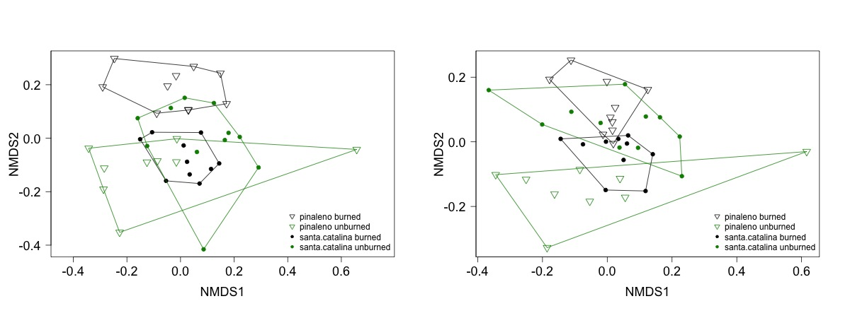
Community similarities
Jaccard dissimilarity index
Morisita dissimilarity index

